Slide 1
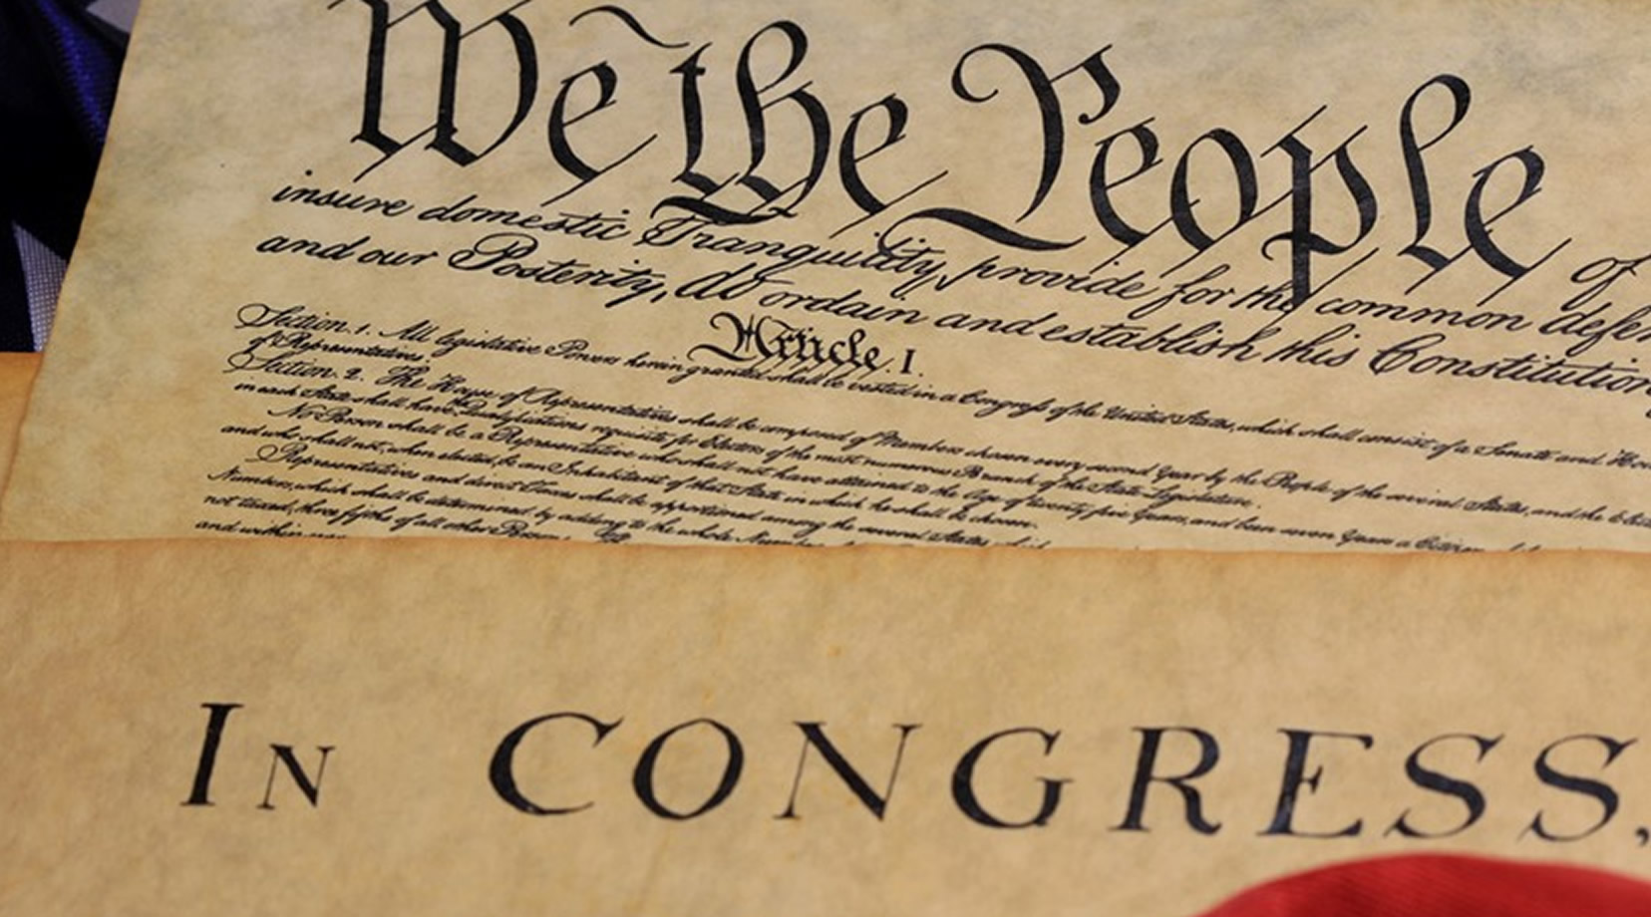
THE AFFIDAVIT PROCESS….
And more importantly, the WHY!

Slide 2
First…..Something about Status.
Let’s talk about who is at the top of the Status food chain…
1st: God/Creator
2nd: Man/Woman - All Men/Women are created equal
3rd: Government - created by Man/Woman
4th: Corporations - also created by Man/Woman
5th: Titles of ANY kind - Judge, Attorney, Defendant, Plaintiff, Police Officer, Clerk of the Court, Governor, Lt. Governor, Taxpayer, Resident, Citizen, etc……...
This is why we must NEVER relinquish our status as a Man or Woman. PERIOD.

Slide 3
IT ALL COMES DOWN TO JURISDICTION
If you accept the lower title, you now fall under their jurisdiction, and more importantly, you WAIVE YOUR CONSTITUTIONALLY GUARANTEED RIGHTS!
LAWS, STATUES, CODES, AND ORDINANCES
These do not apply to a man or women, only residents, citizens, drivers of motor vehicles and so on.
This is why you are issued a citation for a moving violation because this is a CODE violation, NOT A CRIME. No victim, no crime.
THE STATE OF UTAH, THE COUNTY OF SALT LAKE, OR UTAH, SUMMIT, THE CITY OF SALT LAKE, OR PROVO, OR OGDEN
These are NOT government bodies, they are corporations with Dunn & Bradstreet numbers. They are FOR profit organizations.
The only way these corporations retain jurisdiction over us, WE THE PEOPLE, is if we accept the title they give us. Resident, citizen, person, individual, taxpayer and so on.
PEOPLE IN THE GOVERNMENT CANNOT MANDATE YOUR RIGHTS AWAY! (but they can if you consent to it!)

Slide 4
THE GOLDEN RULE:
Do no harm to your fellow man.

Slide 5
Ok, so what do we do when WE have been harmed?

Slide 6
We serve the offending party with AFFIDAVITS

Slide 7
What’s an AFFIDAVIT?
Simply put, an affidavit is out of court sworn testimony. Think of this being the same as if you were called to the witness stand, raised your right hand and said “I swear to tell the truth, the whole truth, and nothing but the truth, so help me God.”

Slide 8
The Affidavit Process:
STEP 1:
Serve the offending party with an Affidavit of Status, an Affidavit of Fact, and a Notice of Claim
STEP 2:
File State and Federal criminal complaints with your local county District Attorney, the state Attorney General, and the U.S. Attorney General
STEP 3:
File a court case in Federal Court under Title 42, section 1983 - Deprivation of Rights lawsuit

Slide 9
The Affidavit of Status: I, Man/Woman
“This affidavit puts it on record that we are asserting our status as a living man or woman, and NOT any of the titles that the people in government or corporations want us to assume. You will see that we write this affidavit in such a way that no one can rebut our statements. An unrebutted affidavit is truth in fact in a court of law once it has been entered as evidence.”

Slide 10
First-Middle Last
2550 S Any street
Anytown, Utah (zip code)
(000)000-0000 youremailhere@anymaill.com
AFFIDAVIT OF STATUS
I,First-Middle Last, a wo/man, am over the age of consent, am a creation of God-Almighty and a follower of God’s laws first and foremost, and the laws of man when they are not in conflict (Leviticus 18:3,4). Pursuant to Matthew 5:33-37 and James 5:12, let my yea be yea, and my nay be nay, as supported by Federal Public Law 97-280, 96 Stat. 1211 - “Whereas the Bible, the Word of God, has made a unique contribution in shaping the United States as a distinctive and blessed nation and people'' and “Whereas Biblical teachings inspired concepts of civil government that are contained in our Declaration of Independence and the Constitution of the United States'' and “Whereas the Bible is "the rock on which our Republic rests”.
I have personal knowledge of the matters stated herein and hereby asseverate, understanding both the spiritual and legal liabilities of, “Thou shalt not bear false witness against thy neighbor”.
1. I am a wo/man, and one of the People of these United States of America, being a creation of God and domiciled in one of the several States.
2. I am, a living, breathing, sentient being on the land, a Natural creation of God and therefore am not and cannot be any ARTIFICIAL PERSON or LEGAL PERSON and, therefore, am exempt from any and all identifications, medical treatments, or medical experiments, and/or requirements, as such pursuant to any process, law, code, or statute, mandate, or any color thereof.

Slide 11
The Affidavit of Fact: The REAL Facts
“This affidavit puts out the facts as you know them to be true. This is the what happened, the where, the why, and so on. This is also the affidavit where we cite state and federal criminal codes/statutes that apply to our case. Unlike the living man/woman, statutes, codes, and laws apply to people who are Public Servants or operating in their capacity in their official title.”

Slide 12
AFFIDAVIT OF FACT
In The Matter Of:
First-Middle Last, a man/woman
To:
Trespasser, a man/woman;
Trespasser
Certified Mail #:
Dear Trespasser, a man/woman,
You, Trespasser, a man, have Trespassed, Assaulted, Battered, and Administered my Property without right. I, a man, have personal knowledge of, and asseverate the following:
1. I, a man, claim my body, information, genetic material, offspring, all that I own and claim [God-given rights] are my Property.
2. I, a man, claim First-Middle Last, (your home address goes here) is my property.
3. I, a man, am not Property of another man, woman, or corporation.
4. I, a man, claim my body, information, and my genetic material [including offspring] are my PROPERTY, and I do not consent to any man or woman Trespassing upon my Property.
PROPERTY: “That which belongs exclusively to one”. “The right and interest which a [wo]man has in lands and chattels to the exclusion of others”.

Slide 13
The Notice of Claim: i.e. The Bill
“This is a notice of the damages that we are claiming against the other party. This is the bill. There are two types of damages allowed under current US Law: compensatory and punitive. Compensatory are actual amounts you suffered by the opposing party, you damaged my car and the repair total is $4,600. Punitive damages can be whatever we want them to be. The sky's the limit.”

Slide 14
NOTICE OF CLAIM
To: Trespasser, a man [public servant], and all parties in interest
Certified Mail #:
Dear Trespasser, a man [Trespasser]:
A Claim has been made against you for the amount of $1,905,403.03, for your role and actions in Trespassing, Assault, Battery, Administering my Property without right, and for Slander against I, a man. You are only a public servant, nothing more, and are non-compliant with the Constitutions and Laws that bind you; and have exceeded the limited powers that we the People have delegated to you through the Constitution and Laws.
You have ten [10] days upon receipt to either rebut the Affidavit of Fact point-for-point, with your Affidavit or I will begin to proceed with Administrative, Civil, and Criminal remedies against Trespasser, a man. Failure to rebut the Affidavit of Fact will result in the Trespasser’s tacit agreement and acquiescence that the facts set forth in it are true, correct, accurate, not misleading, and binding to the Trespasser. This will result in the execution of this Claim against Trespasser, a man [Trespasser], and the unrebutted Affidavit of Fact being used against Trespasser, a man [Trespasser], in future Civil and Criminal proceedings.

Slide 15
Any Questions?

